Slide 1
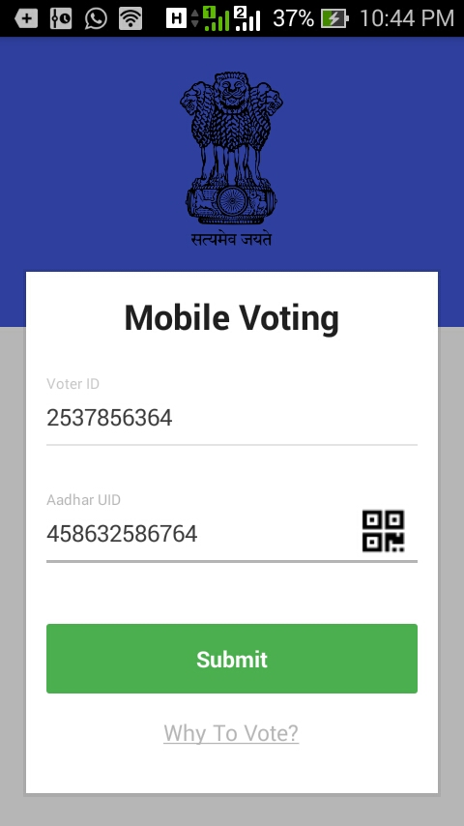
E-Voting
(Mobile Voting)
Made by :- Vishal Maan (12H51A05H8) N.Sunil (13H55A0519) Gedela Bangaru Naidu (12H51A05D9)

Slide 2
Abstract
This project deals with voting with just few clicks on your Android powered Cell Phone.
This project aims for the betterment of Indian Voting/Election System.
Our Application is very Time Efficient and allows people of India to vote from anywhere in just few seconds.
Basic idea of online voting is to reduce the rush during election season and Increase number of voters.

Slide 3



Technologies
 | Technology | Tool/Software Used
Front End | Android | Android Studio
Backend | php | php 5.5
Database | Mysql | Mysql 5.6

Slide 4


Slide 5
Login Screen – UI
Login Activity Contains Voter ID and Aadhar UID as Numeric Inputs.
Every Voter ID is linked to Unique Aadhar UID stored on Database

Slide 6

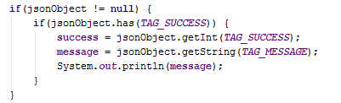
Login Screen - Code
Voter ID and Aadhar UID are parameter's provided to REST(Representational State Transfer) API.
And REST object provided to JSONObject as Args.
Now In case we receive null for jsonObject we need to print error. If not null then successful login and display party List screen.

Slide 7
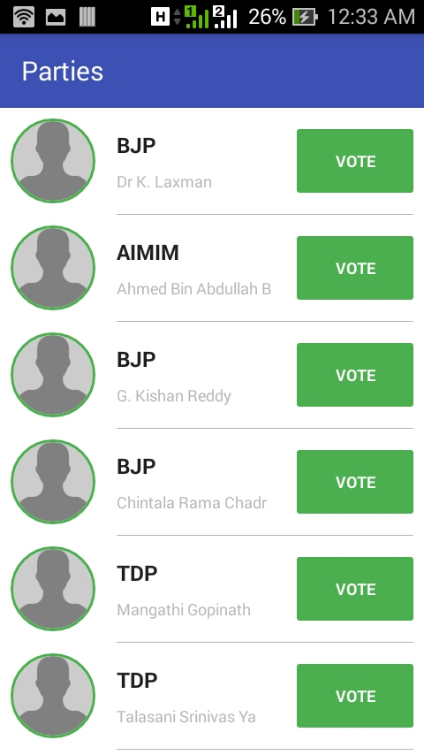
Party List Screen – UI
Parties List screen contains ListView with Party Symbol, Party Name and Candidate Name.
User need to click on desired Party Vote Button to Vote.
And your vote will be submitted.

Slide 8

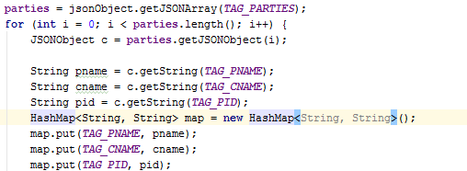
Party List Screen - Code
REST API is executed and Response is passed to JSON Object.
Each JSONObject(c) is taken from JSONArray (parties) and each party details are added to HashMap.
Now each HashMap are added to ArrayList of HashMap type.

Slide 9


Slide 10

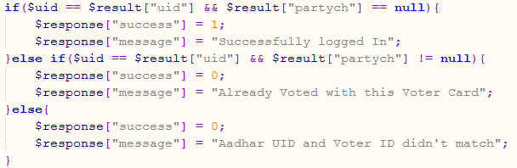
Authenticate User
Authenticate User is called when user log in by sending Voter ID and Aadhar UID as POST Method. Php page receive arguments.
Search query is executed to obtain results.
Result is checked for null and response is set.
Finally response is sent back as JSONArray.

Slide 11
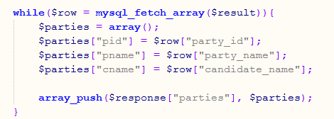

Display Parties List
When Application send HTTPRequest to get_all_parties.php search query is executed.
New Array Parties is created of type JSONArray to store parties data.
Each data field is added to array.
Response is sent back to Application as JSONArray.

Slide 12


Slide 13

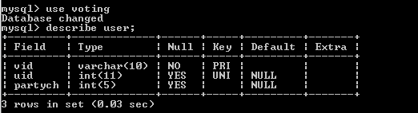
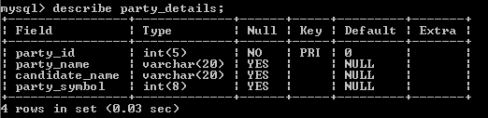
Mysql Database Structure
Database -> Voting
Table -> user will store the user details(voter ID, aadhar UID, party choice)
Table -> party_details will store party details(Party id, party name, candidate name)

Slide 14


